Slide 1

NCDF T2 Architecture Views
Pam Dargan
13 July 2023

Slide 2
NCDF TT Architecture Status
Subset of team met to develop architecture views that focused on the 2023 implementation of the NCDF Data Lake
FMN Jour Fixe Spiral 5 Architects provided feedback on early versions and recommended combining NAFV4 design patterns
Views combine logical and physical NAFV4 design patterns
Logical symbology for what Nations will implement
Physical symbology for what NCIA implemented
Plan to use for discussions that drive the future architecture
Expect architecture to grow as it provides for new functionality
Architecture views will show the changes over time

Slide 3
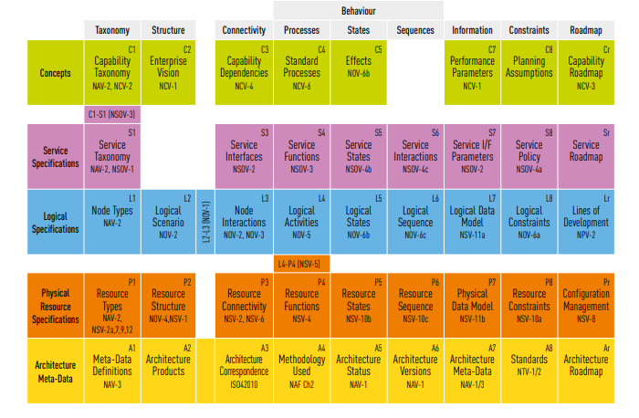
Focus of 2023 NCDF Architecture Views
Node Interactions (L3)
Identifies all relevant interactions between nodes
Logical Sequence (L6)
Identifies and describes the chronological sequence of activities and/ or logical flows in a scenario
Resource Structure (P2)
Represents the composition and (high-level) interaction of resources
Will refer to this as “Physical Information Exchanges”

Slide 4

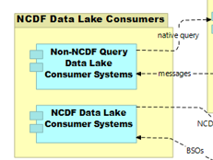
Node Interactions-Physical Information Exchanges View (L3-P2)
NAFV4 L3-P2 uses the symbology shown below
Cylinder on yellow box represents a business role
Yellow box without a cylinder indicates a group of components
Dashed lines indicate data flows
Blue box w/attached smaller boxes represents an application or application component, a physical node

Slide 5
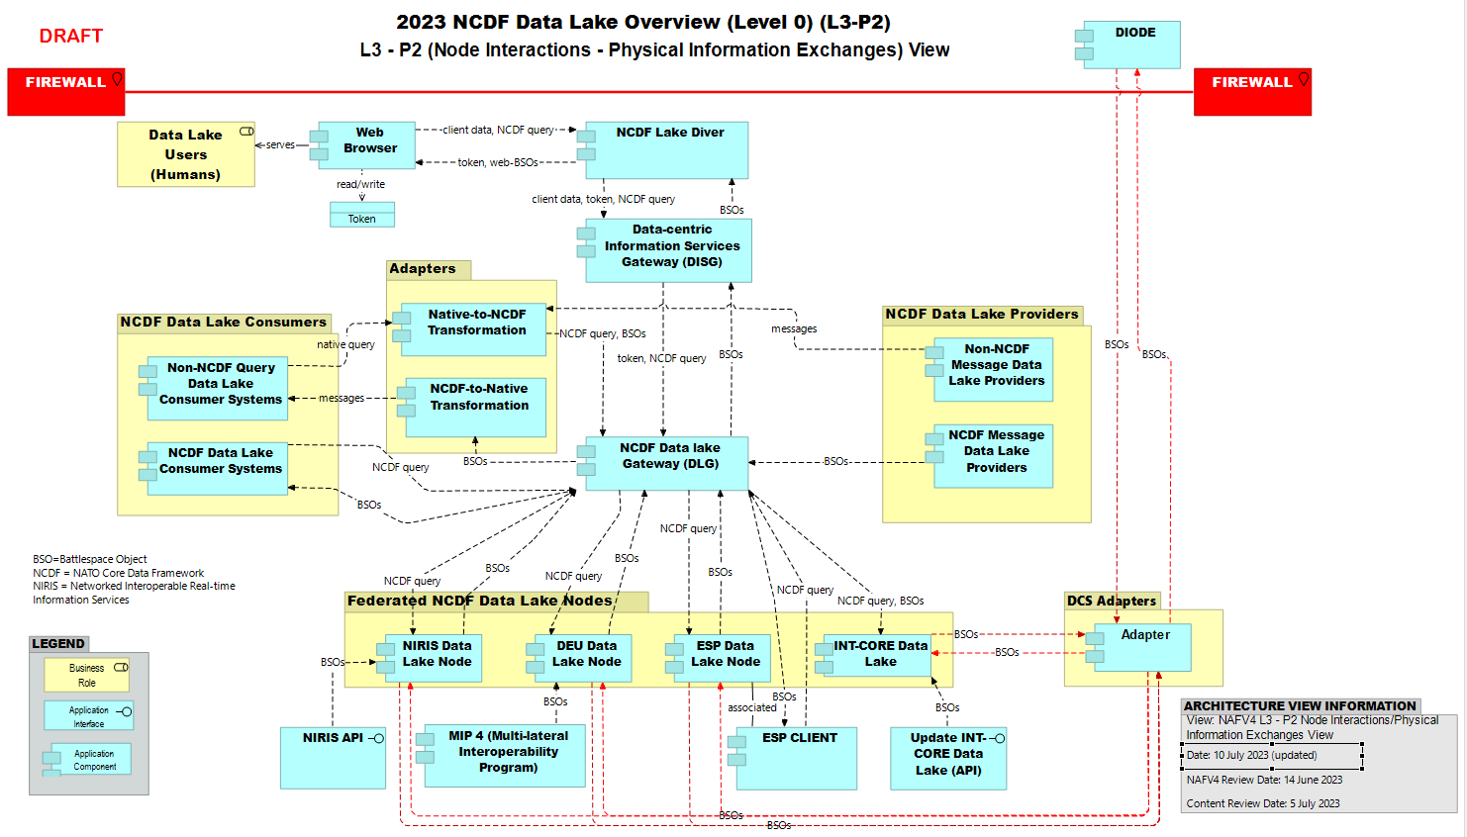
2023 NCDF Data Lake Overview (Level 0) L2-P3

Slide 6



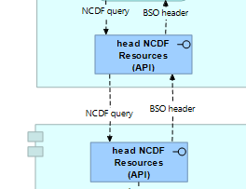


Logical Sequence – Physical Information Exchanges (L6 – P2)
NAFV4 L6-P2 uses additional symbology, as shown below
Symbols to the left represent an event
Green shows start of event, red ends an event
NCDF Data Lake Gateway
Right arrow box symbolizes a business process
Application Program Interface (API) represents an application call to another application
NCDF Data Lake Provider
Logical sequence views start from the left and move down, then back up
Similar to how swim lanes are represented
Boxes with this notation represent a function
Yellow symbolizes business function; blue symbolizes an application function

Slide 7
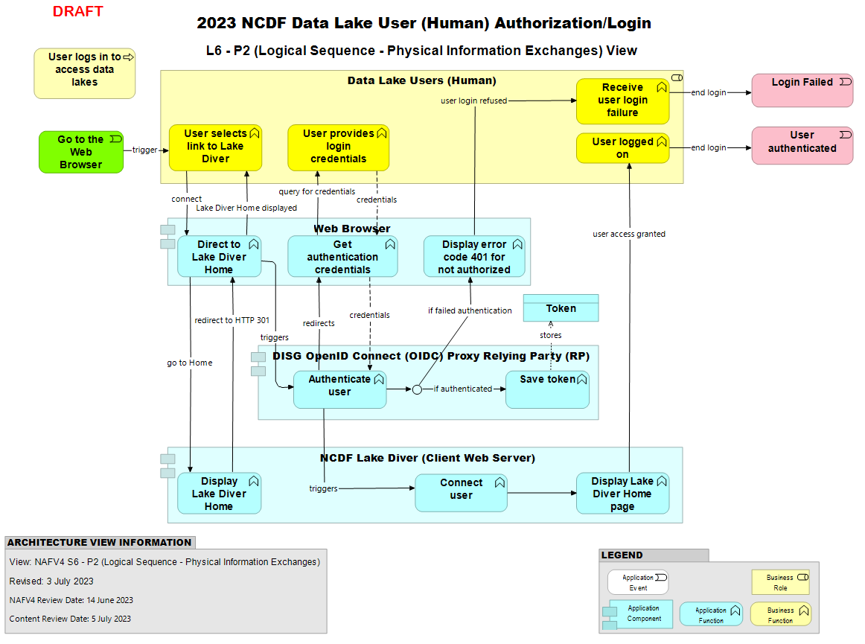
2023 NCDF Data Lake User Authorization/Login

Slide 8
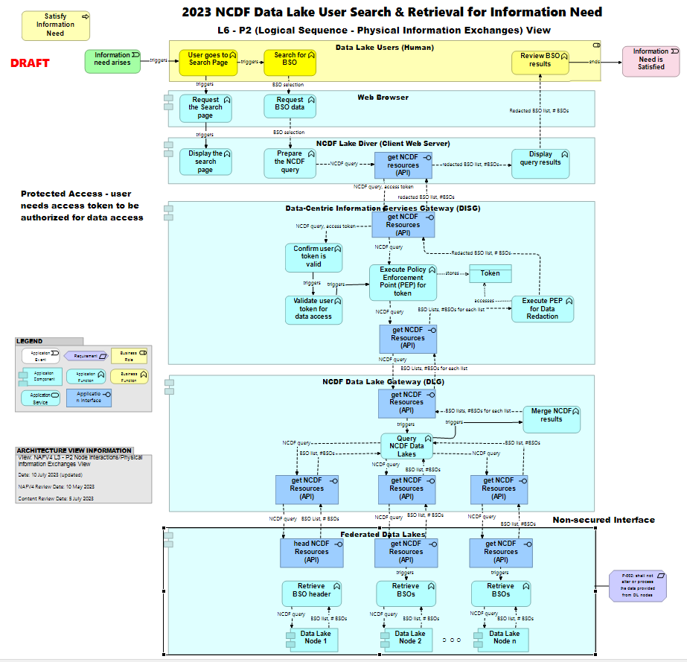
2023 NCDF Data Lake User Search for Information Need

Slide 9
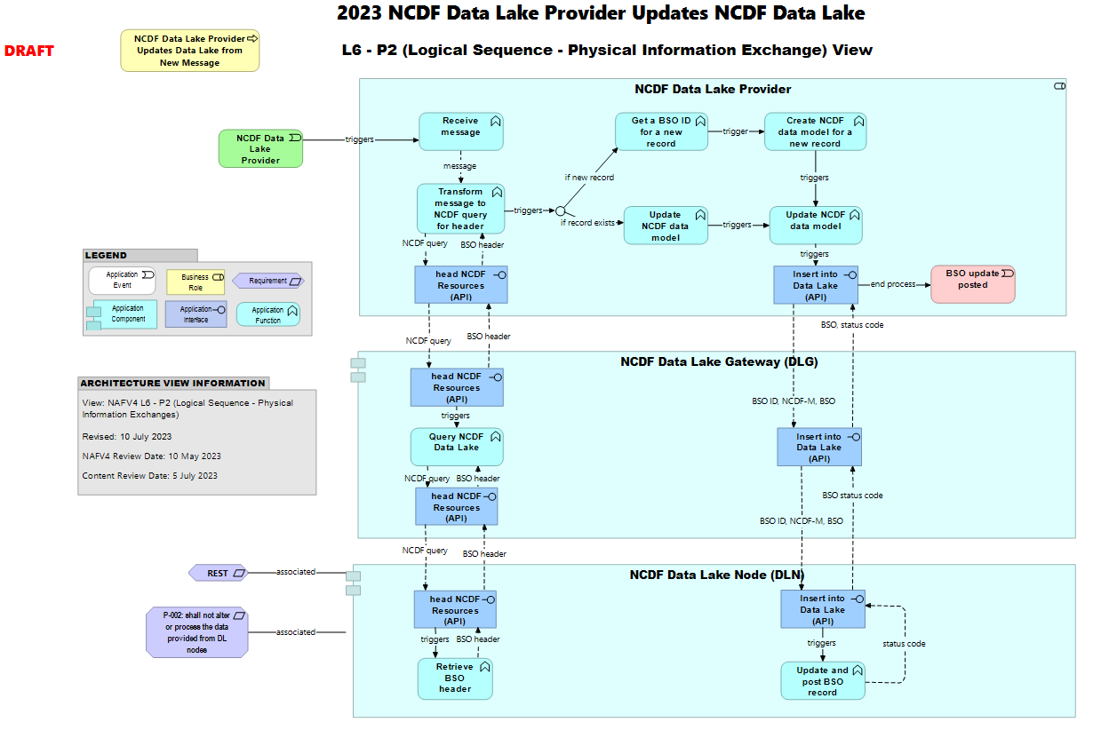
2023 NCDF Data Lake Provider Updates NCDF Data Lake

Slide 10
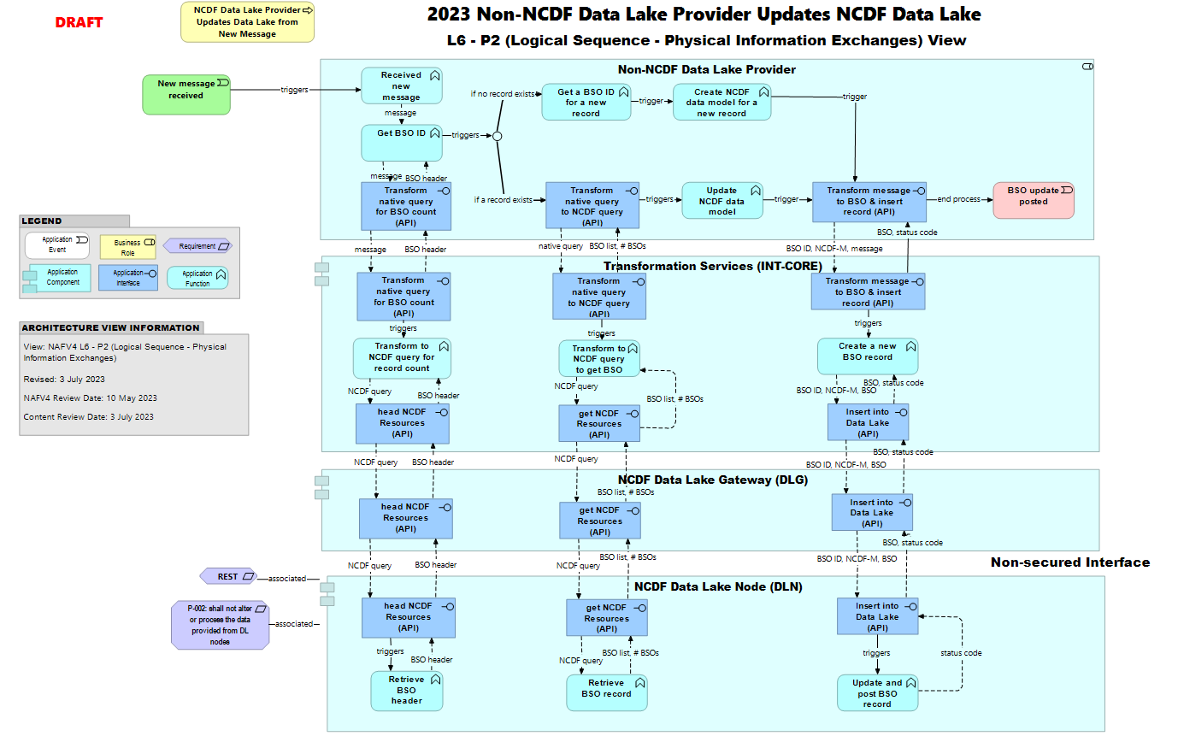
2023 Non-NCDF Data Lake Provider Updates NCDF Data Lake

